Slide 1
HeLa Cell and Nucleus Segmentation Using U-Net
Ganesh Reddy G 22BCE1898
Mukunda Hosangadi 22BCE1870
Sumedh Kudale 22BCE1193
BCSE403L Digital Image Processing
Prof. Geetha S
Vellore Institute of Technology Chennai
Winter Semester 2024-25

Slide 2
Introduction
Problem Statement:
Automated and precise segmentation of HeLa cells and their nuclei in microscopy images is a critical task in computational biology, enabling high-throughput quantitative analysis for applications such as drug screening, cell tracking, and morphological studies.
Technical Challenge:
Traditional image processing techniques struggle with the complex morphology, overlapping structures, and heterogeneous intensity patterns characteristic of HeLa cell images, necessitating advanced, data-driven approaches.

Slide 3
Proposed Solution:
We leverage a U-Net-based deep convolutional neural network architecture, specifically designed for biomedical image segmentation, to perform end-to-end pixel-wise classification and delineate both cell and nucleus boundaries with high fidelity.
Significance:
This approach combines Deep-Learning with an Image Processing pipeline to enable reproducible, scalable, and objective segmentation, facilitating downstream computational analysis and accelerating biomedical research workflows.

Slide 4
Related Work
Karabağ et al.[2] conducted a comprehensive evaluation of deep learning architectures for semantic segmentation of HeLa cells, comparing the performance of VGG16, ResNet18, Inception ResNet-v2, and the U-Net model. Their work highlighted the strengths and limitations of each architecture in terms of segmentation accuracy and computational efficiency, with U-Net emerging as a particularly effective solution for biomedical image segmentation tasks due to its encoder-decoder structure and skip connections.
Building upon this foundation, Duque-Vazquez et al. advanced the field by developing a purely digital image processing pipeline that bypassed the need for deep learning models. Their approach leveraged classical image processing techniques to achieve superior segmentation results compared to previous deep learning-based methods, while also significantly reducing computational resource requirements.
Notes:
PubMed [36] contains more than 33,000 entries with the words cell and classification or
segmentation in the title and abstract ((classification[Title/Abstract] OR segmentation[Title/
Abstract]) AND cell[Title/Abstract]). The number of entries drops considerably to less than
1000 when the keyword “electron” is added to the search.
ML/DL Approach
Pure DIP approach
Our approach involves a combination of both

Slide 5
References
Duque-Vazquez, Edgar F et al. “HeLa cell segmentation using digital image processing.” Heliyon vol. 10,5 e26520. 21 Feb. 2024, doi:10.1016/j.heliyon.2024.e26520
Karabağ C, Jones ML, Peddie CJ, Weston AE, Collinson LM, Reyes-Aldasoro CC (2020) Semantic segmentation of HeLa cells: An objective comparison between one traditional algorithm and four deep-learning architectures. PLoS ONE 15(10): e0230605. https://doi.org/10.1371/journal.pone.0230605
Larissa Heinrich, Davis Bennett, David Ackerman, Woohyun Park, John Bogovic, Nils Eckstein, Alyson Petruncio, Jody Clements, Song Pang, C. Shan Xu, et al., Whole-cell organelle segmentation in volume electron microscopy, Nature 599 (7883) (2021) 141–146.
Fatima Boukari, Sokratis Makrogiannis, Joint level-set and spatio-temporal motion detection for cell segmentation, BMC Med. Genom. 9 (2) (2016) 179–194
Notes:
Larissa Heinrich We also show that such reconstructions can be used to automatically register light and electron microscopy images for correlative studies. We have created an open data and open-source web repository, ‘OpenOrganelle’, to share the data, computer code and trained models, which will enable scientists everywhere to query and further improve automatic reconstruction of these datasets.
Fatima Boukari
In this study, we propose a joint spatio-temporal diffusion and region-based level-set optimization approach for moving cell segmentation. Moving regions are initially detected in each set of three consecutive sequence images by numerically solving a system of coupled spatio-temporal partial differential equations.

Slide 6
References
Tim Scherr, Katharina Löffler, Moritz Böhland, Ralf Mikut, Cell segmentation and tracking using CNN-based distance predictions and a graph-based matching strategy, PLoS ONE 15 (12) (2020) e0243219.
Ranjith Unnikrishnan, Caroline Pantofaru, Martial Hebert, Toward objective evaluation of image segmentation algorithms, IEEE Trans. Pattern Anal. Mach. Intell. 29 (6) (2007) 929–944.
Deng J, Dong W, Socher R, Li LJ, Li K, Fei-Fei L. Imagenet: A large-scale hierarchical image database. In: 2009 IEEE conference on computer vision and pattern recognition. IEEE; 2009. p. 248–255.
Deerinck TJ, Bushong E, Thor A, Ellisman MH. NCMIR—National Center for Microscopy and Imaging Research. NCMIR methods for 3D EM: A new protocol for preparation of biological specimens for serial block-face SEM Microscopy; 2010.
Notes:
Tim Scherr
By using a novel representation of cell borders, inspired by distance maps, our method is capable to utilize not only touching cells but also close cells in the training process.For the prediction of the proposed neighbor distances, an adapted U-Net convolutional neural network (CNN) with two decoder paths is used. In addition, we adapt a graph-based cell tracking algorithm to evaluate our proposed method on the task of cell tracking.
Ranjith Unnikrishnan
This is largely due to image segmentation being an ill-defined problem-there is no unique ground-truth segmentation of an image against which the output of an algorithm may be compared. This paper demonstrates how a recently proposed measure of similarity, the normalized probabilistic rand (NPR) index
Deng J,
Deerinck TJ

Slide 7
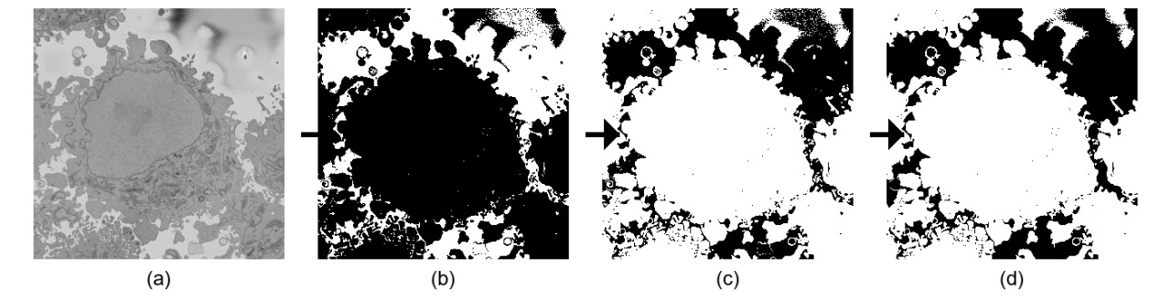
Preprocessing
Input Image Thresholded Negative Fill Holes

Slide 8
U-Net Introduction
What is U-Net?
A convolutional neural network designed for biomedical image segmentation.
Encoder-decoder structure with skip connections which help help to recover fine grained details in the prediction
Advantages:
Works well with limited annotated data.
Preserves spatial information via skip connections.

Slide 9
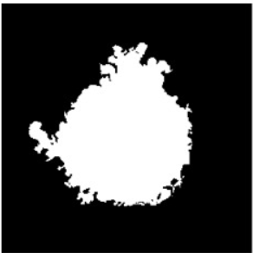
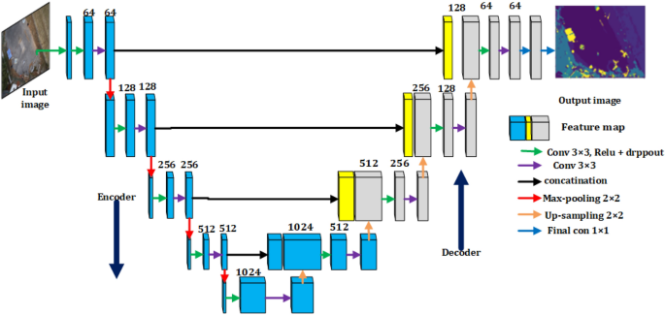
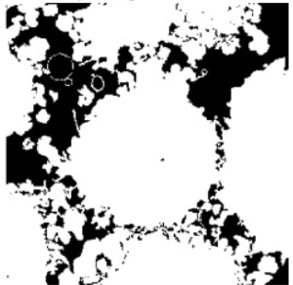
Architecture of U-Net

Slide 10
Nucleus Segmentation
Noise Reduction & Edge Detection:
Applied a standard deviation filter to reduce noise, followed by Canny edge detection to highlight cell and nucleus boundaries.
Edge Enhancement:
Dilated the detected edges to ensure continuity and better separation of adjacent structures.
Mask Preparation:
Inverted the binary edge map (negative transformation) and filled internal holes to create solid masks representing cells and nuclei.
Verification & Nucleus Detection:
Verified the processed masks for accuracy and extracted nucleus regions to be used as ground truth for model training.

Slide 11
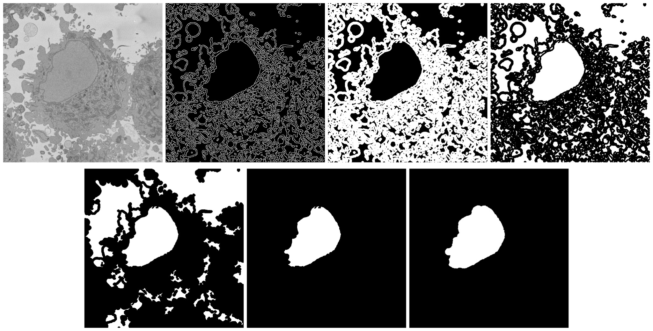
Input Image Standard filter and Canny Dilate Edges Negative
Fill holes Verification Steps (f1) Detected Nucleus

Slide 12
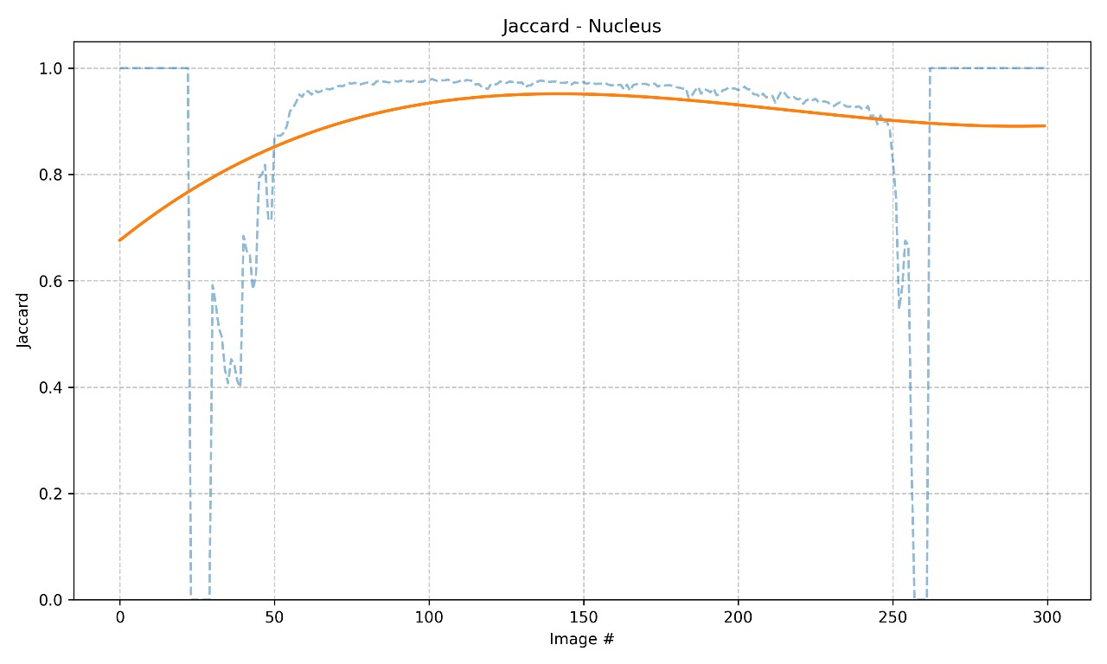
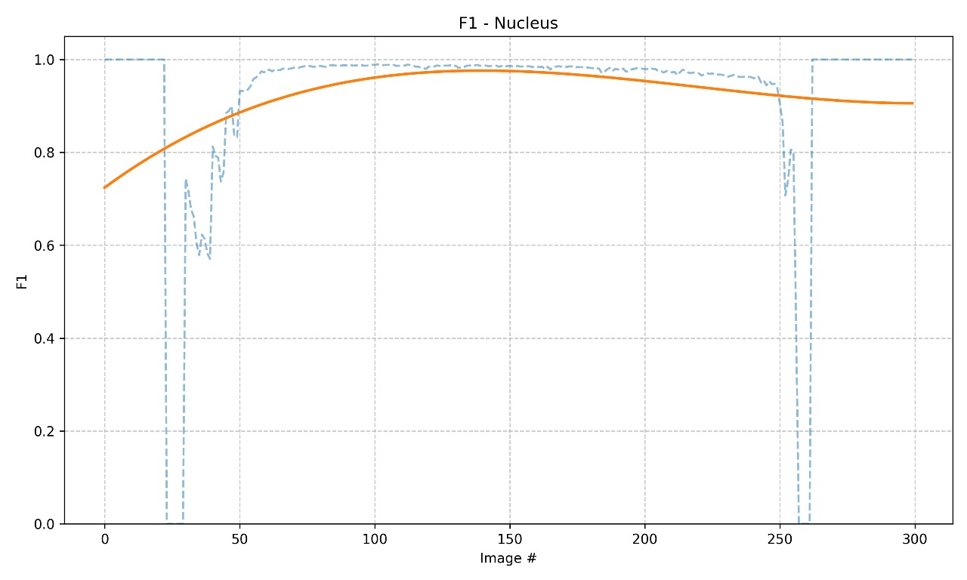
Visual representation for Accuracy of Image Processing

Slide 13
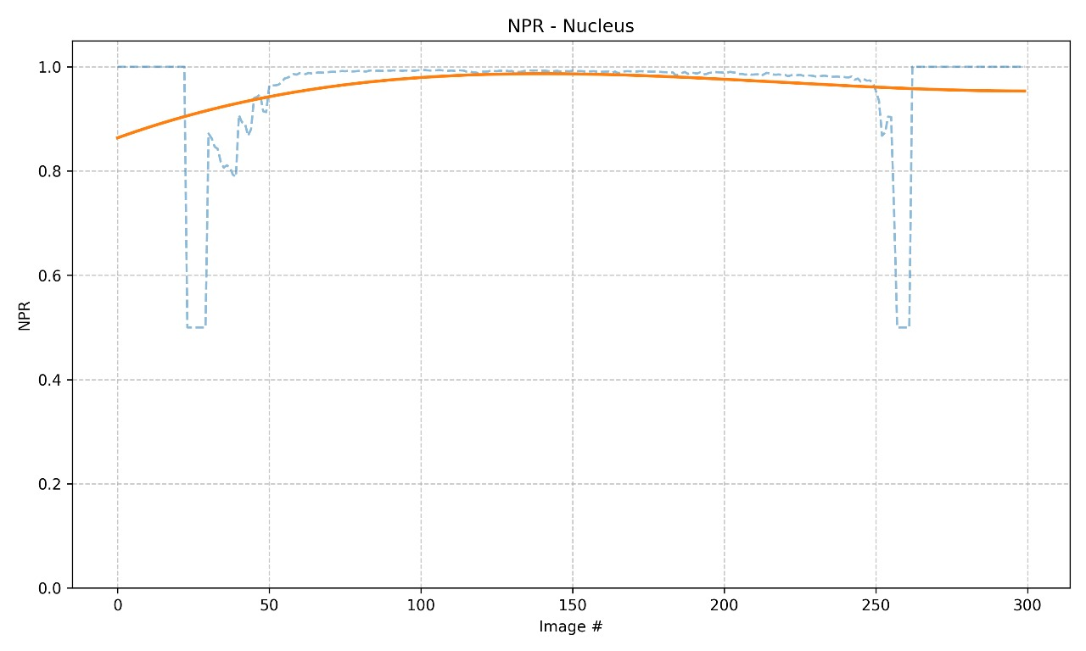
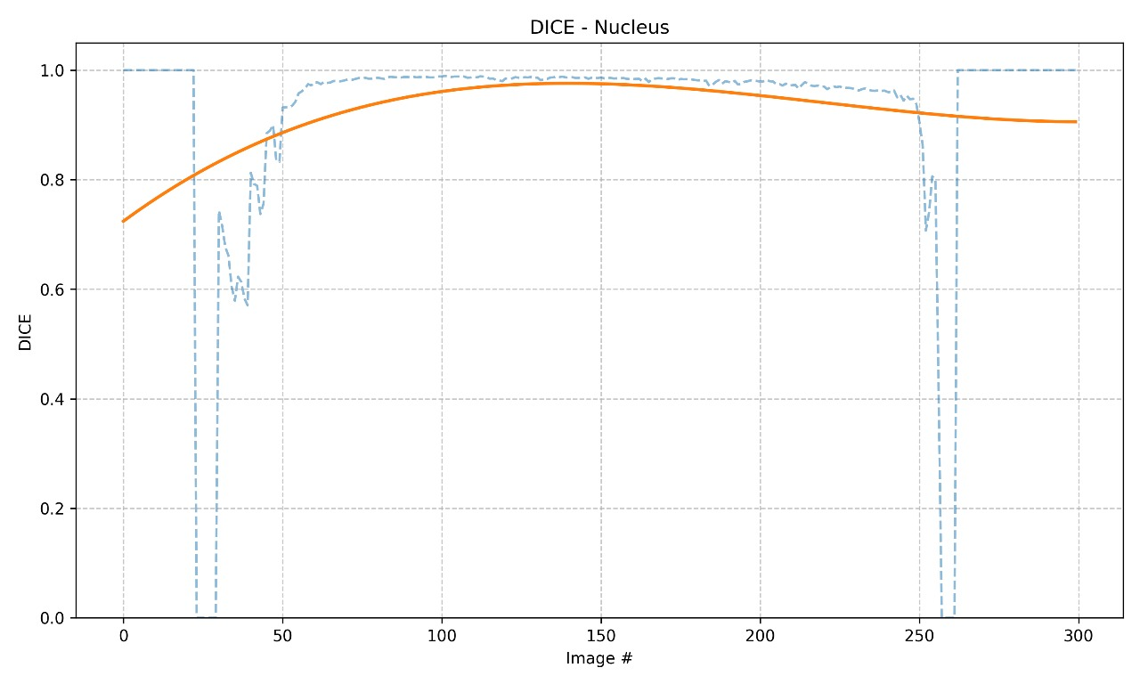

Slide 14
Metrics
Jaccard Index (IoU):
Measures the overlap between the predicted mask and the ground truth, calculated as the intersection over union of the two regions.
Dice Coefficient:
Assesses similarity between predicted and true masks, emphasizing the harmonic mean of precision and recall.
F1-Score:
Represents the balance between precision and recall for the segmentation, equivalent to the Dice coefficient for binary masks.
Pixel Accuracy:
Calculates the percentage of correctly classified pixels over the total number of pixels.

Slide 15
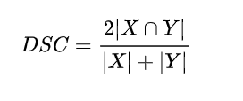
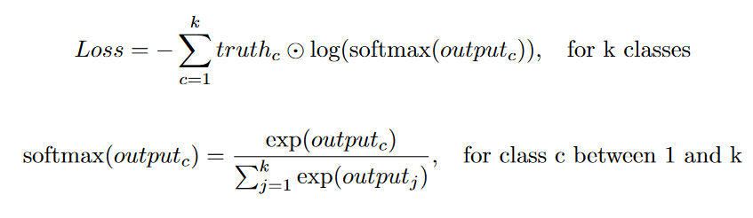
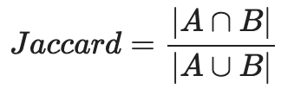
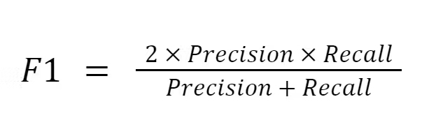
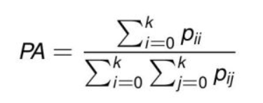
Formulas
For U-Net,

Slide 16
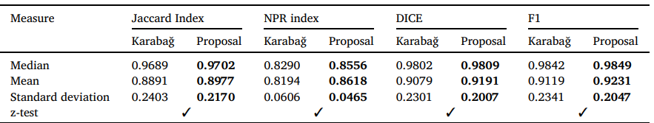
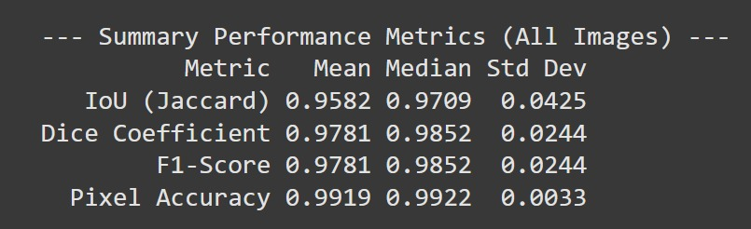
Results Comparison to previous papers

Slide 17
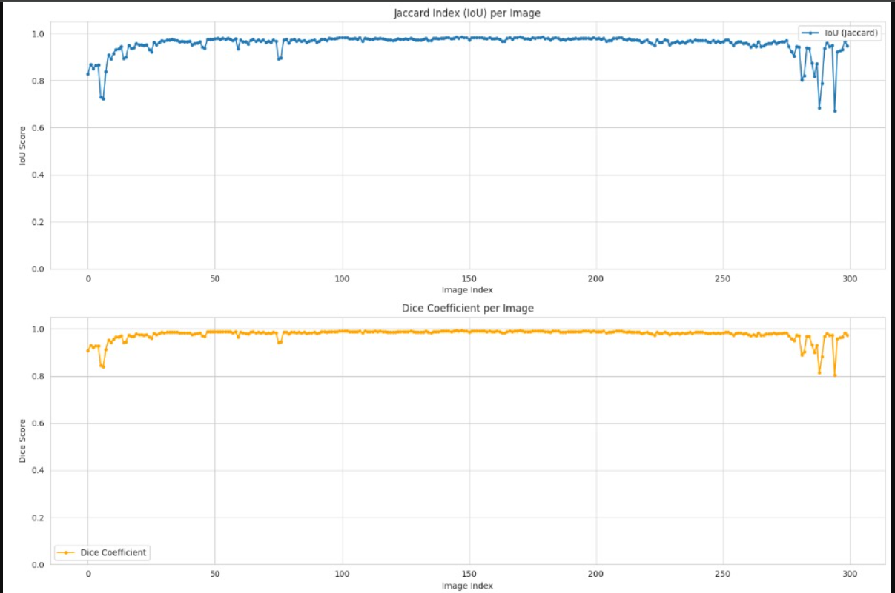
Plot of Results per Image

Slide 18
